Slide 1
Multi layer Perceptron

Slide 2
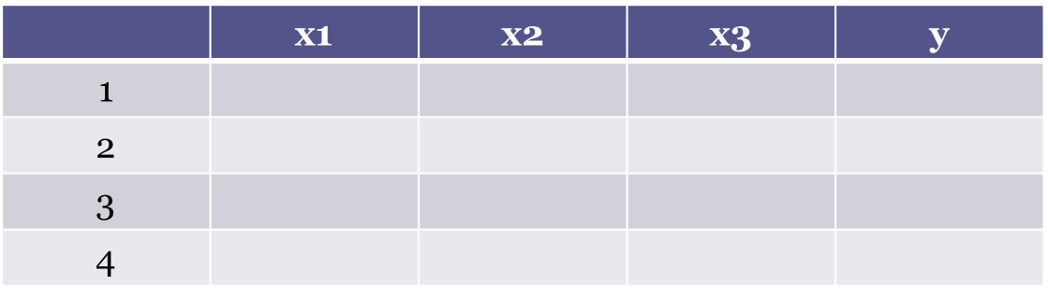
Perceptron
The basic element present in the neural network is perceptron.
Perceptron works very much similar to neurons present in our central nervous system.
Consider a sample dataset,

Slide 3
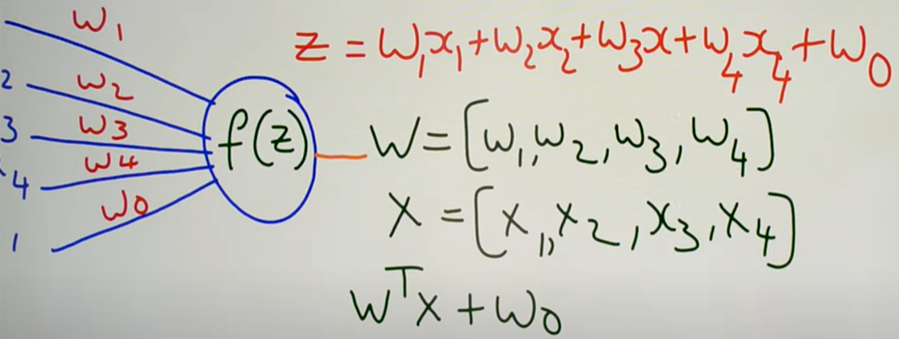
Input giving to the perceptron, we call it as feed forwarding

Slide 4
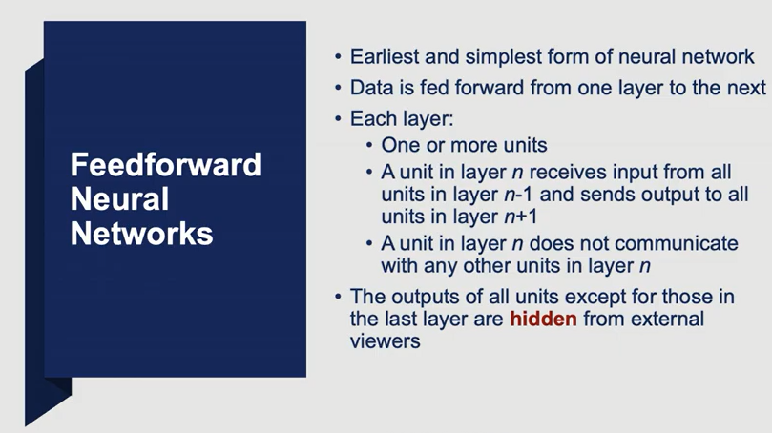

Slide 5
In feed forward neural network connections between the nodes does not form a cycle.
Opposite of Feed forward neural network is Recurrent Neural Network (RNN) – here certain pathways are cycled.
Feed forward neural network processed in only one direction.
While the data may pass through multiple hidden nodes, it always moves in one direction and never backwards.

Slide 6
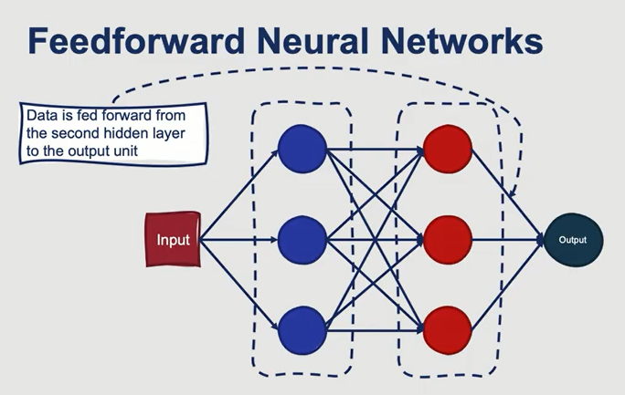

Slide 7
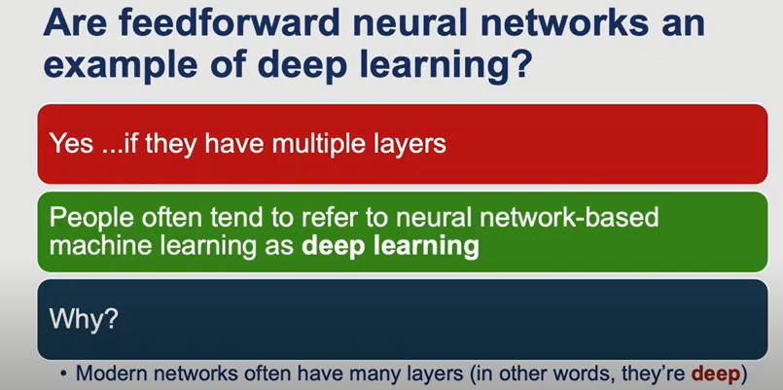

Slide 8
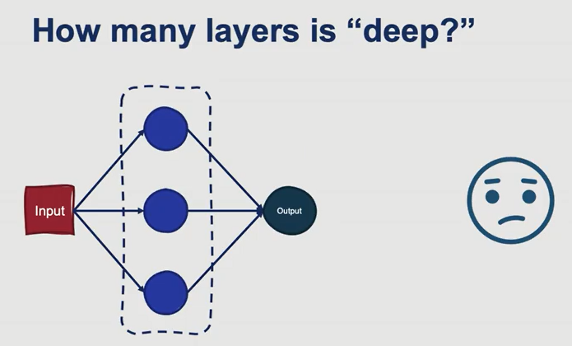

Slide 9
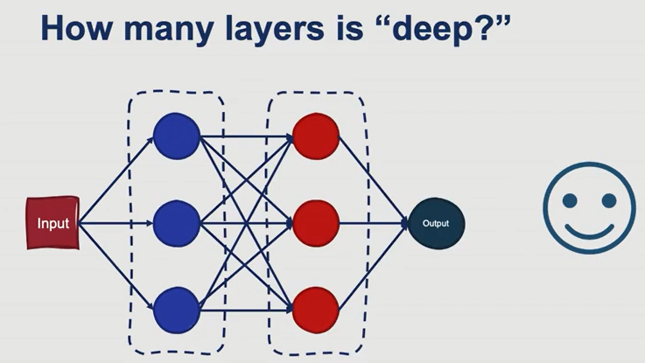

Slide 10
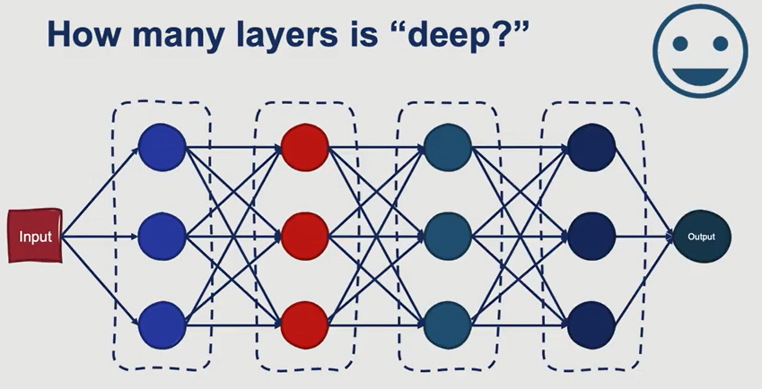
If the number of hidden layers is greater than 1, then it is called Deep Network

Slide 11
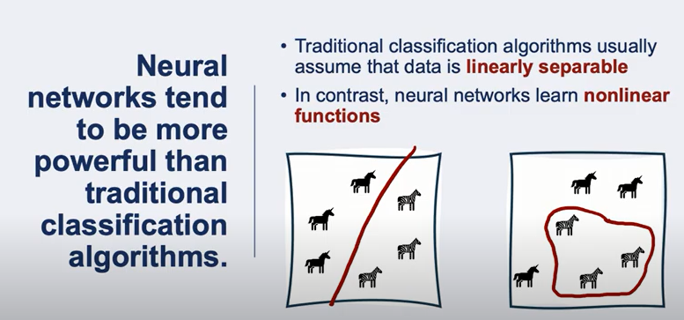

Slide 12
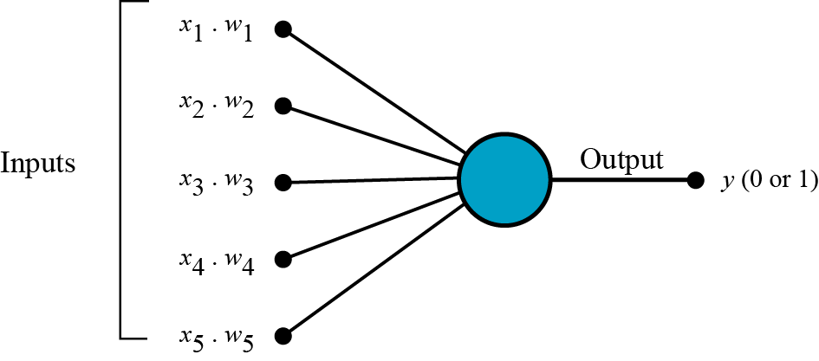
Perceptron
A Feed Forward Neural Network is seen in its simplest form as a single layer perceptron.
Inputs are combined in a weighted sum and, if the weighted sum exceeds a predefined threshold, the neuron fires and produces an output.

Slide 13
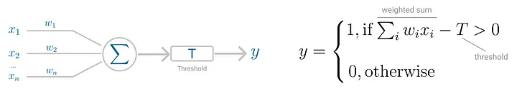
Weights are generated randomly
Threshold T represents the activation function.
If the weighted sum of the inputs is greater than zero the neuron outputs the value 1, otherwise the output value is zero.

Slide 14
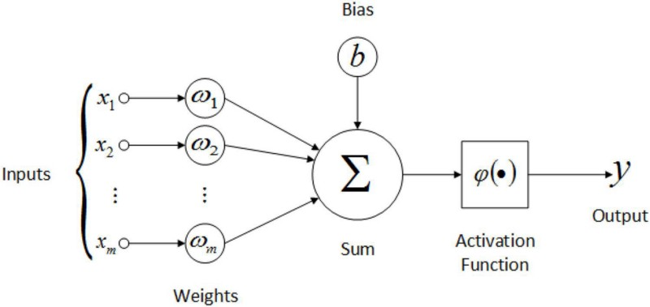

Slide 15
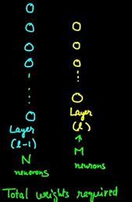
= N x M + Bias
Bias will be different for each neuron

Slide 16
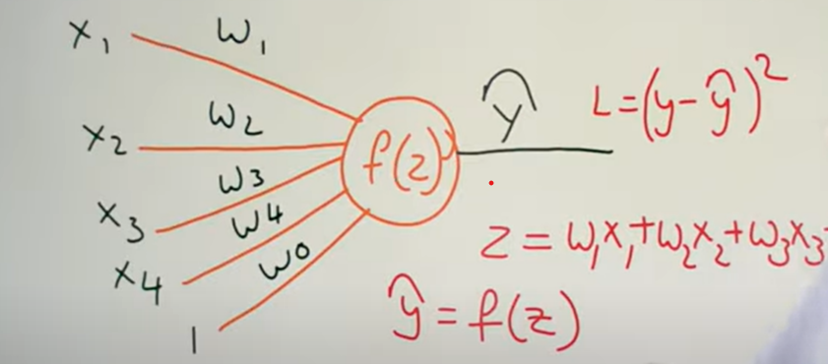
Training a Single Perceptron

Slide 17
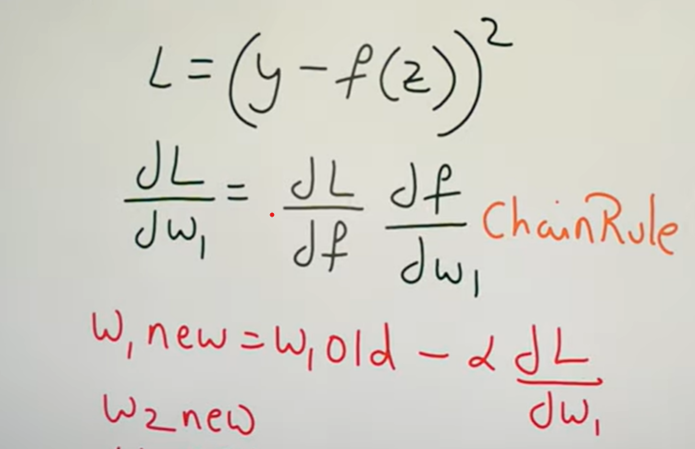
Updating weights, w values – Back propagation

Slide 18
Feed Forward Process – Given input x, given all the weights of a single layer & by taking a linear combination, non linearity; linear combination, non linearity; linear combination, non linearity, y can be predicted.

Slide 19
Single Layer Perceptron for Binary Classification
Perceptron can be used as a binary classification model, defining a linear decision boundary.
Assumption – Perceptron works on data that should be linearly separable.

Slide 20
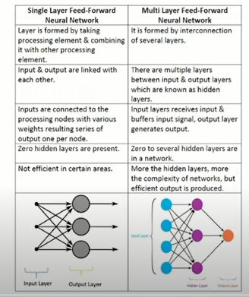

Slide 21
Perceptron Vs Multilayer Perceptron
Perceptron | Multilayer Perceptron
1. Perceptron deals with linear data | 1. Multilayer perceptron deals with non linear data
2. Neurons in perceptron use ReLU or Sigmoid activation function | 2. Neurons in Multilayer perceptron use any activation function

Slide 22
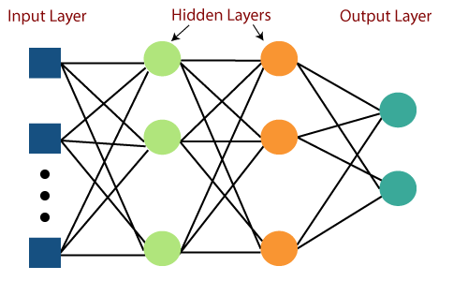
Multilayer Perceptron
A fully connected multi-layer neural network is called a Multilayer Perceptron (MLP).
It is a most complex architecture of Artificial Neural Network (ANN).

Slide 23
MLP is a feed forward artificial neural network that generates a set of outputs from a set of inputs.
In MLP, the mapping between inputs and output is non-linear.
MLP is characterized by several layers of input nodes connected as a directed graph between the input nodes and output layers.
MLP uses backpropagation for training the network.
It has 3 layers including one input layer, one hidden layer and one output layer.
If it has more than 1 hidden layer, it is called a deep ANN.

Slide 24
MLP Learning Procedure
The MLP learning procedure is as follows:
Starting with the input layer, propagate data forward to the output layer. This step is the forward propagation.
Based on the output, calculate the error (the difference between the predicted and known outcome). The error needs to be minimized.
Backpropagate the error. Find its derivative with respect to each weight in the network, and update the model.
Repeat the three steps given above over multiple epochs to learn ideal weights.
Finally, the output is taken via a threshold function to obtain the predicted class labels.

